Slide 1
Spoken Word Recognition with Liquid State Machines
EE 746 2021
Vivek Saraswat, Prof. Udayan Ganguly
https://arxiv.org/abs/1901.06240 (LSM)
https://arxiv.org/ftp/arxiv/papers/2104/2104.14264.pdf (LSM)
https://arxiv.org/abs/1902.09726 (neuron)

Slide 2
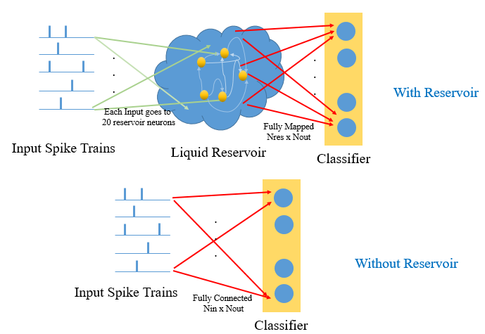
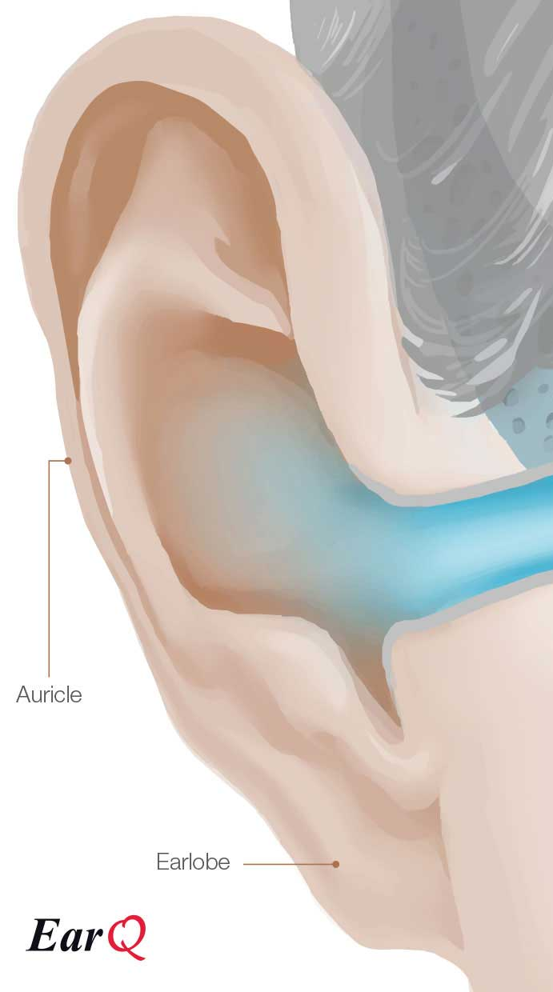


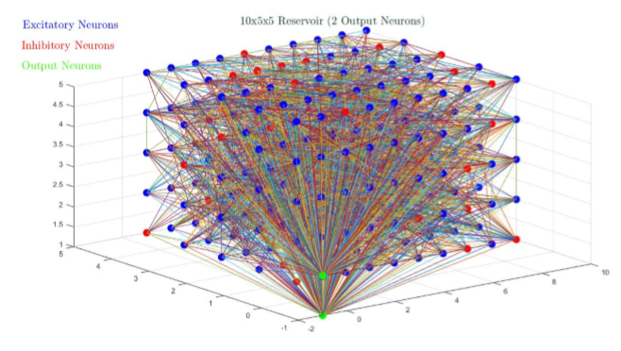
Liquid State Machine
b a t
time
bbbb
aaa
t
time

Slide 3
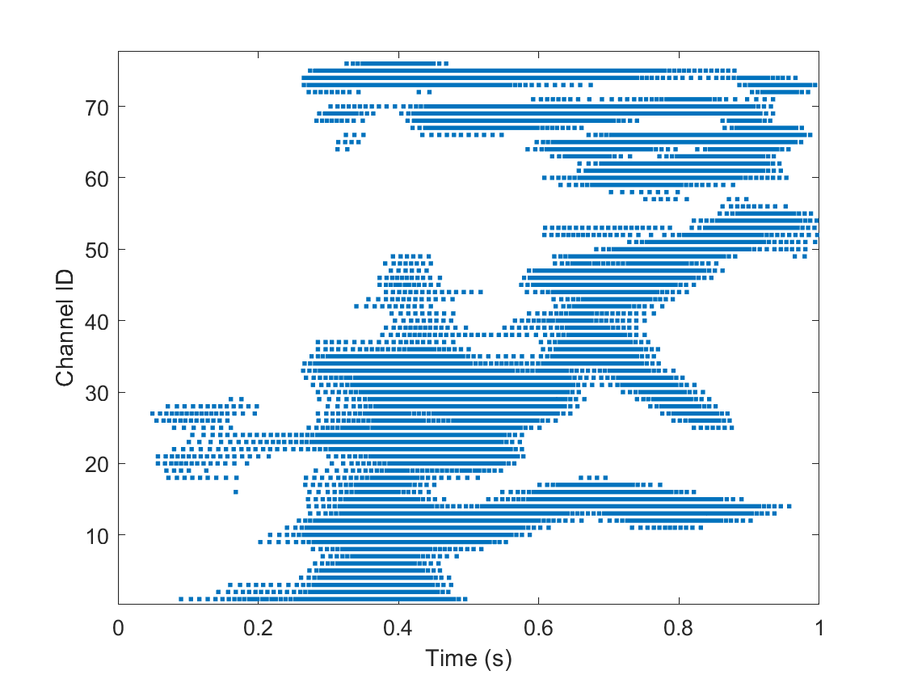
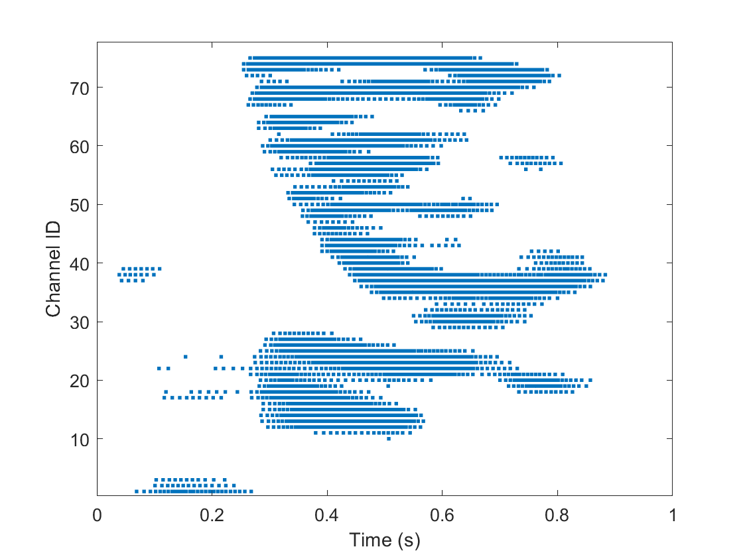
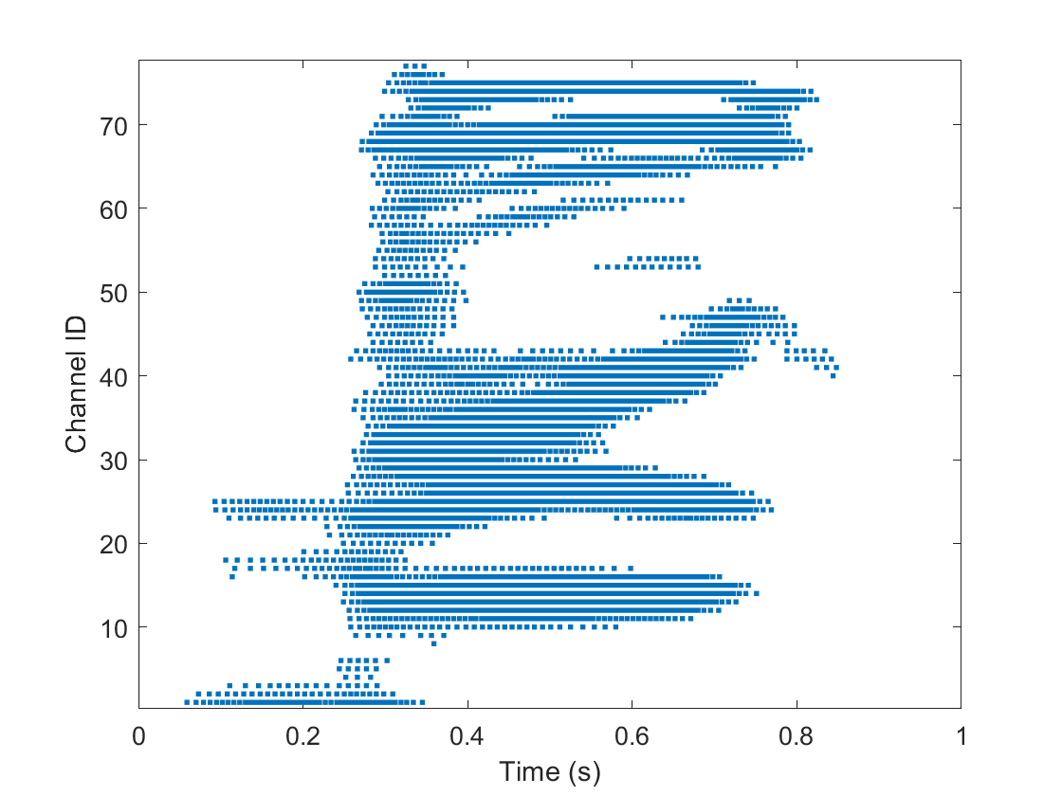
Spoken Digits as Spikes in Time
“Zero”
“One”
“Two”
Spectrogram:
Each Channel filters frequency in log scale and coverts into spikes in time
Q1: Looking at the raster scans, can you tell them apart? Can you see the “pterodactyl”, “wolf/eagle” or the “ hanging snake”?
Answer: Yes. It is true that you can recognise patterns in the images, but the brain does not see it this way all at once, but the pattern unfolds in time (x-axis)
Q2. Can we learn a pattern of spikes in time?
Answer: We have done this in HW in a 2 layer fully connected Neural Network; So we detect co-incidence (blue circle) and delayed co-incidence (green circles).
Q3: Delayed Coincidence is just Delay + Coincidence. So how can we create a delay?
Answer: Any neuronal loop can produce a delay
Q3: Do we a priori know the value of delay? If not, how do we make a network with all possible delays?
Answer: A random connection of neurons will create random sized loops to produce all possible delays, without doing any design. This is a fundamental property of randomness.

Slide 4
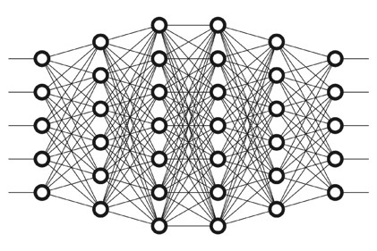
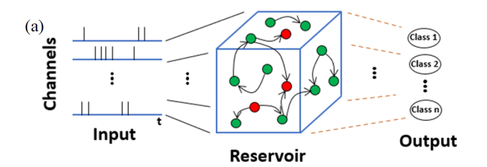
Artificial vs. Biological Neural Network
Deep Neural Network: Each layer is a learning Layer
Single Learning Layer for Classification
Liquid State Machine: This consists of two parts
Reservoir : Recurrent Random NN with fixed synapses
Classification Layer: Single layer learning synapses
2
Q1: Which one looks more biological?
Answer: LSM looks more disordered – less designed like biology
Q2: Which one has less number of parameters?
Answer: LSM has only one learning layer ➔ less parameters
1
Random Recurrent Connected Neural Network

Slide 5
Motivation
Neurons, synapses
Good performance is attributed to recurrent non-linear dynamics
Quantify how much non-linearity these systems possess!
Computations in an LSM are thought to be mysterious due to their recurrent random connectivity
Modelling of these systems!
Due to vast parameter design space, tuning is costly
Is there a better performance predictor?

Slide 6
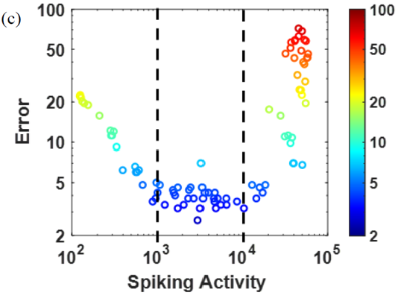

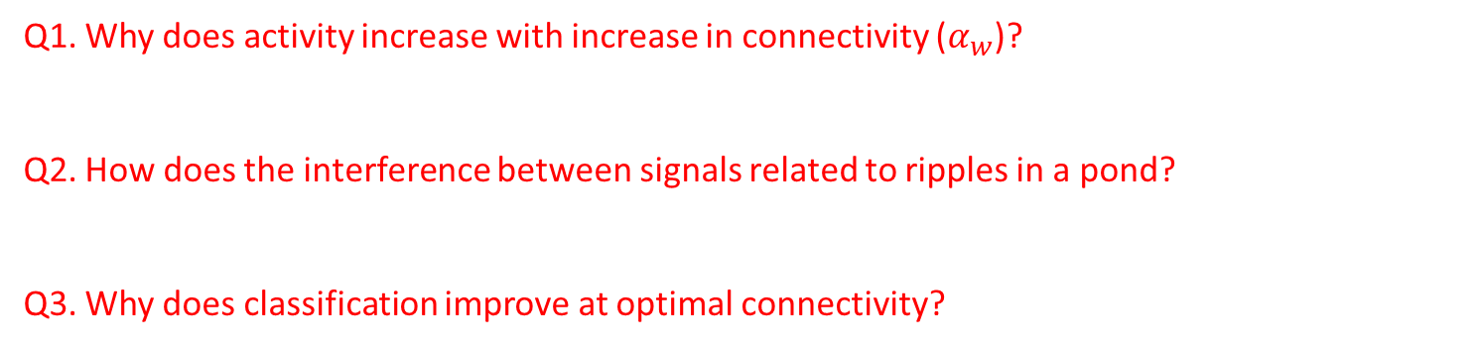
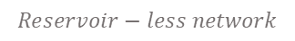
Performance prediction by Spiking Activity
Reservoir Spike Rate
Classifier Performance
Optimal Activity Leads to Performance
$$Reservoir−less network$$
Q1. Why does activity increase with increase in connectivity ($α_{w}$)?
Q2. How does the interference between signals related to ripples in a pond?
Q3. Why does classification improve at optimal connectivity?

Slide 7
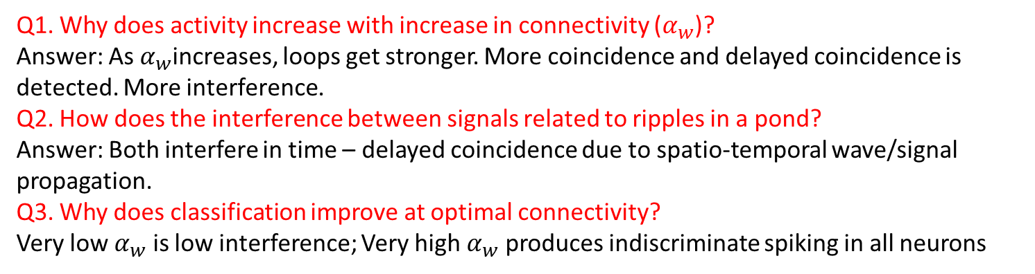
Performance prediction by Spiking Activity
Reservoir Spike Rate
Classifier Performance
Optimal Activity Leads to Performance
$$Reservoir−less network$$
Q1. Why does activity increase with increase in connectivity ($α_{w}$)?
Answer: As $α_{w}$increases, loops get stronger. More coincidence and delayed coincidence is detected. More interference.
Q2. How does the interference between signals related to ripples in a pond?
Answer: Both interfere in time – delayed coincidence due to spatio-temporal wave/signal propagation.
Q3. Why does classification improve at optimal connectivity?
Very low $α_{w}$ is low interference; Very high $α_{w}$ produces indiscriminate spiking in all neurons

Slide 8


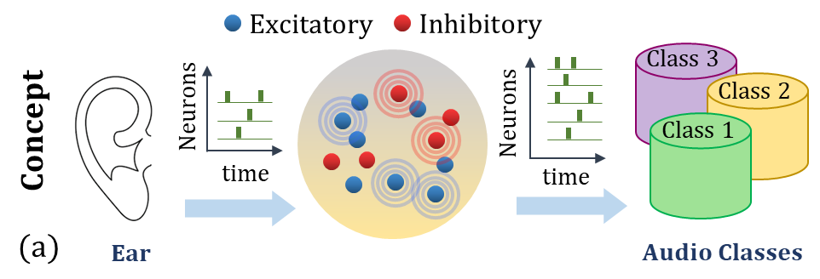
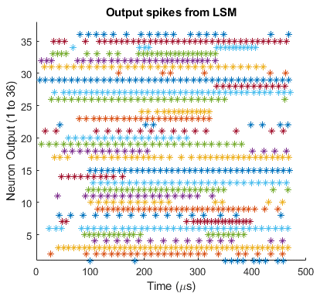
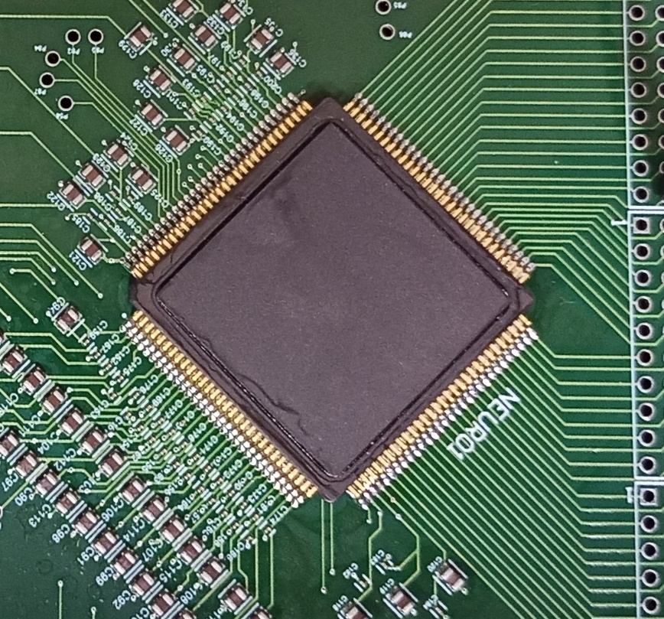
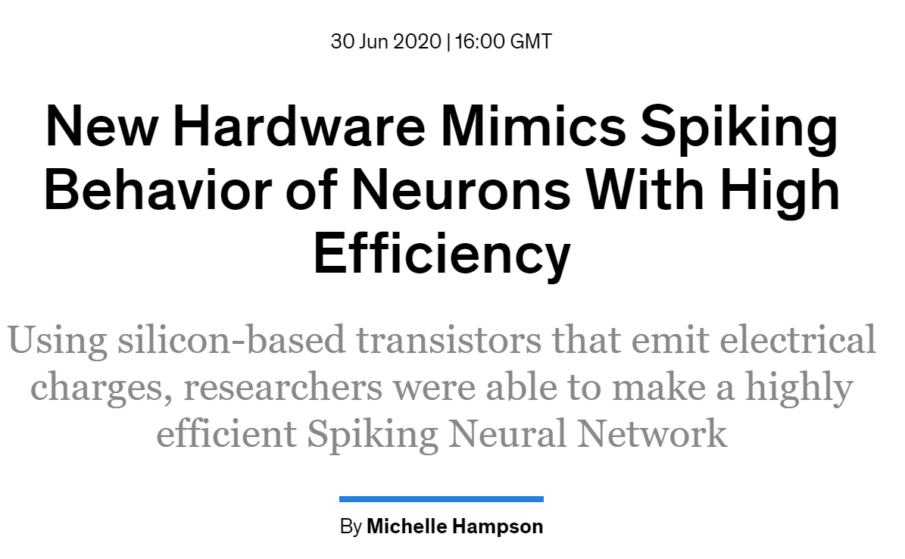
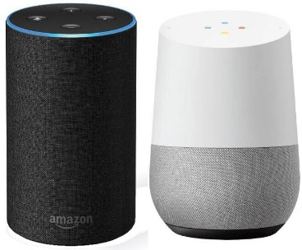
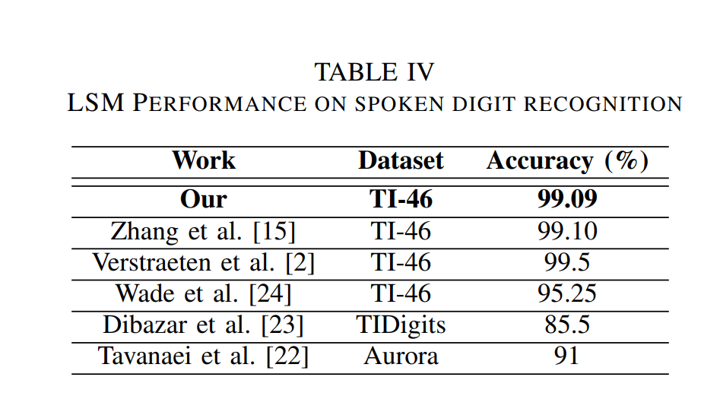
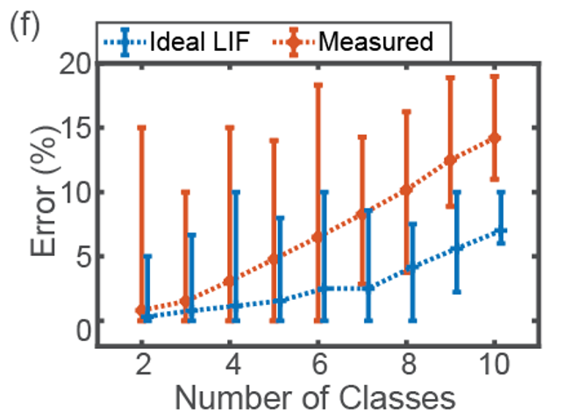

LSM Hardware Development
With Prof Maryam Shojaei Baghini
Our approach: Technology, Algorithms, Circuits for Ultra-low power & compact systems
Received GF University Program support 1.7 Crores INR (200k USD)
First Indian Group to complete successful tape out at 45nm SOI node (fundamentally rad hard).
First 45nm SOI based Neural Network Chip in the world!
1. Technology:
Patented ultra-low power neuron;
2. Algorithm:
Command recognition performance in high;
3. Chip Design & Test:
Command recognition performance in high (1% error);
4. System:
Always-on Command Recognition (ongoing)
Output Spikes 36 neurons
$$Auditory Cortex$$
Okay Google
Hello Alexa
IIT Bombay Spiking NN Chip
Tanmay Chavan et al IITB 2020
Ajay Singh et al IITB 2021

Slide 9
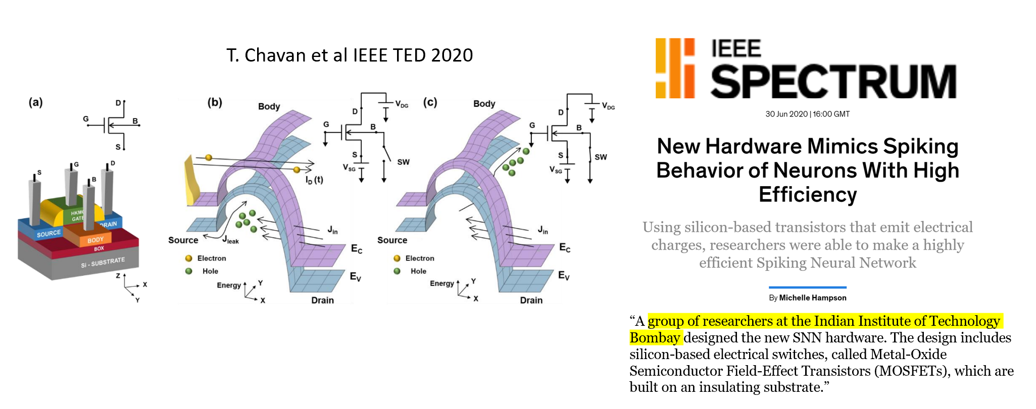
Band to Band Tunneling (BTBT) based Spiking Neuron

Slide 10


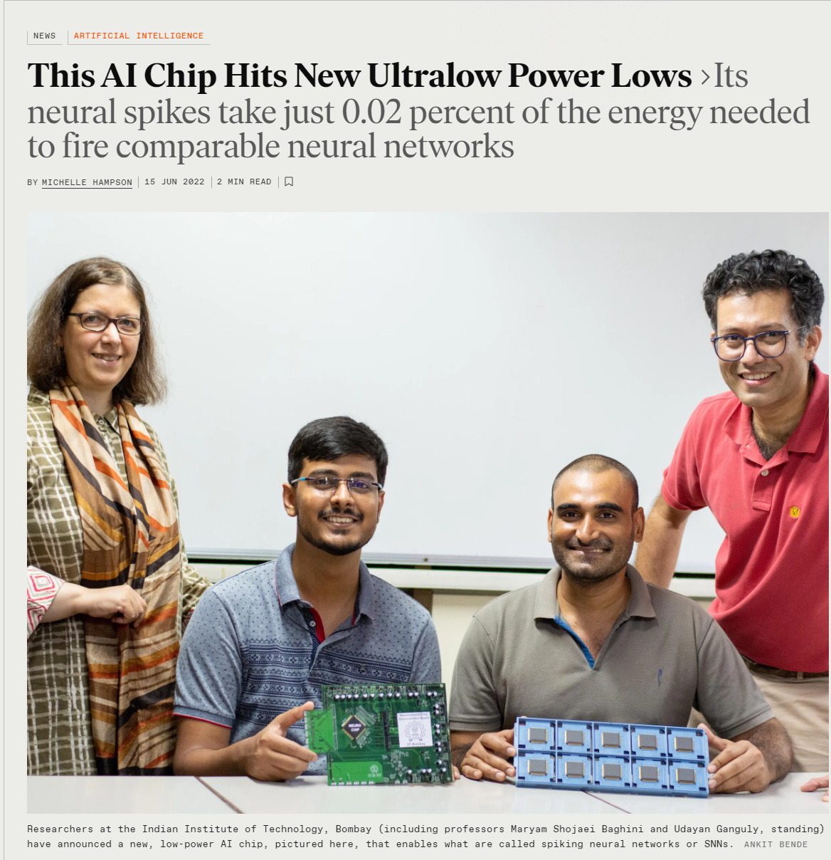
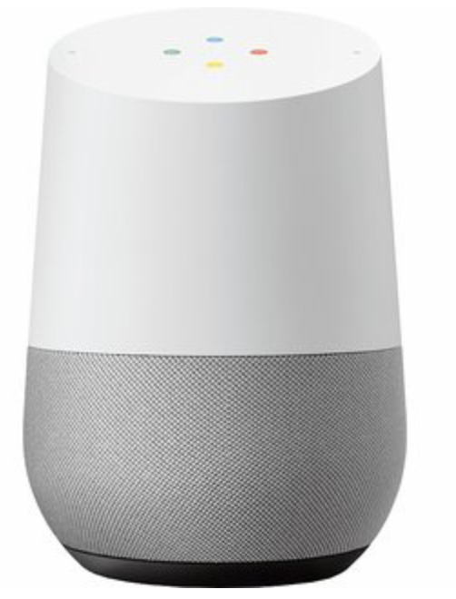


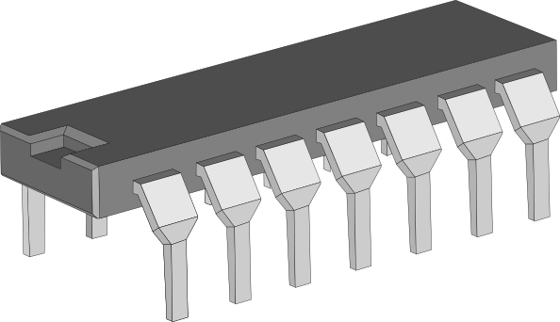


The World’s First Tunnelling Enabled Spiking Neural Network Chip on 45nm SOI Technology from India
Dr. Ted Letavic, CTO of Compute and
Wired Infrastructure Business Unit
GlobalFoundries
“This is pioneering work that showcases the advantages of mature SOI technology to demonstrate a new neural compute paradigm based on quantum tunneling."
June 2022
Prof. Ajay Sood,
Principal Scientific Advisor (PSA)
to the Government of India remarked
“Demonstrating silicon-proven ideas based
on an untapped quantum phenomenon in silicon
to build efficient brain-like computing is promising on the global scale. The confluence of the national semiconductors priority as well as the emergence of AI and brain-scale computing hardware as the R&D focus at the global level makes the demonstration very timely and compelling.”

Slide 11
Hardware Requirement
Always on chip yet mobile application ➔ ultra-low power
Works at kHz speed ➔ yet needs to be super compact ➔ how to slow down CMOS without large capacitors?
Patented neuron physics and design!
Patented neural network!
Potential for a startup!

Slide 12
Thank You!

Slide 13
References
Maass, W. (2011). Liquid state machines: motivation, theory, and applications. In Computability in context: computation and logic in the real world (pp. 275-296).
Verstraeten, D., Schrauwen, B., Stroobandt, D., & Van Campenhout, J. (2005). Isolated word recognition with the liquid state machine: a case study. Information Processing Letters, 95(6), 521-528.
Zhang, Y., Li, P., Jin, Y., & Choe, Y. (2015). A digital liquid state machine with biologically inspired learning and its application to speech recognition. IEEE transactions on neural networks and learning systems, 26(11), 2635-2649.
de Azambuja, R., Klein, F. B., Adams, S. V., Stoelen, M. F., & Cangelosi, A. (2017, May). Short-term plasticity in a liquid state machine biomimetic robot arm controller. In 2017 International Joint Conference on Neural Networks (IJCNN) (pp. 3399-3408). IEEE.
Chrol-Cannon, J., & Jin, Y. (2014). On the correlation between reservoir metrics and performance for time series classification under the influence of synaptic plasticity. PloS one, 9(7), e101792.
Legenstein, R., & Maass, W. (2007). What makes a dynamical system computationally powerful. New directions in statistical signal processing: From systems to brain, 127-154.

